Slide 1


Slide 2
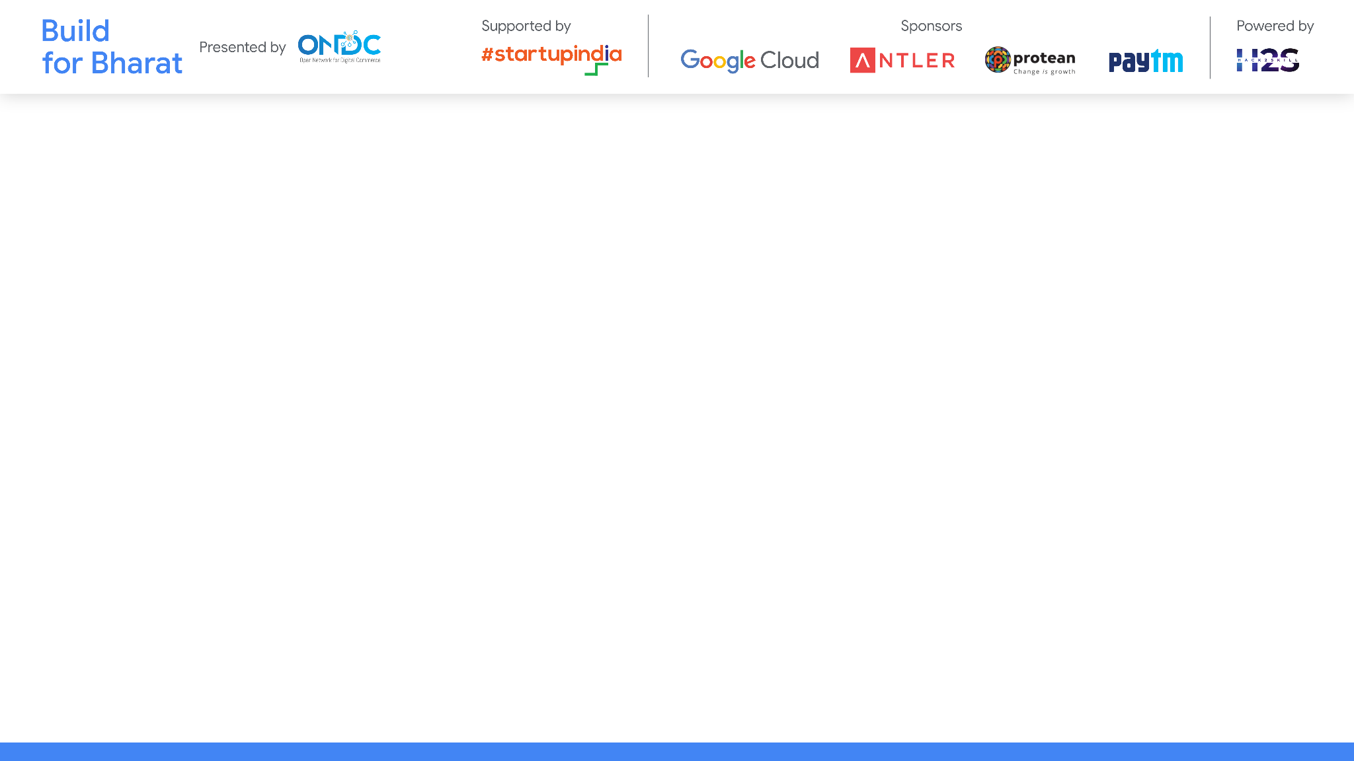
Team Name:ELITE BHARAT
Team Leader Name: SIVARANJANI G
Team Member Names:HARINI P
SWATHIGA P
NARMADHA S
Problem Statement Category: Foundational or Scalable Solution
Problem Statement: Retail Commerce

Slide 3
Architecture & Design for Multimodal Indic Language Support
Overview:
Seamless Indic language support in retail commerce through modular design, scalability, and security.
High-Level Architecture:
Input Module: Text, Voice, Image.
Translation Module: Transformer Models, Text2Vec Pipeline.
Output Module: Text, Voice, Image.
E-commerce Integration Module: Search & Discovery, Payment, Order Updates, Customer Service.
Tech Evaluation:
Reusability: Modular APIs, Algorithms, Versatile Datasets.
Extensibility: Modular Components, Scalable Architecture.
Scalability: Microservices, Capacity Planning.
Security: Transactional Guarantees, Access Controls.

Slide 4
Customization & Deployment
Customization:
UI: Themes, layouts, language preferences.
Culture: Tailored content based on user choices.
Personalization: Allow users to set default preferences.
Deployment:
Cloud: AWS, Azure, GCP for scalable options.
On-Premises: Data security for specific needs.
Containers: Docker for easy portability.
Mobile Apps: iOS and Android deployment options.
Browser Extension: Extend usability across browsers.

Slide 5
Test Cases & Evaluation Data
Test Cases:
Text Input: Indic languages, dialects, emojis.
Voice Input: Accents, speech speeds.
Image Input: Diverse images, OCR accuracy.
Translation: Phrases, idioms, technical terms.
Multimodal Interaction: Seamless transitions, accuracy.
Evaluation Data:
Language Datasets: Indic languages, challenges.
Voice Datasets: Various accents, patterns.
Image Datasets: Indic text, contexts, variations.
Translation Models: Transformer-based, challenges.
User Scenarios: Real-world e-commerce, preferences.

Slide 6
Solution Demonstration
Multimodal Input:
Show text input with Indic languages.
Demonstrate voice input with varying accents.
Display image input recognition with diverse images.
Translation Mechanism:
Showcase accurate translation of diverse text inputs.
Highlight the use of transformer models for linguistic accuracy.
Demonstrate the effectiveness of the text2vec pipeline.
Multimodal Output:
Exhibit translated text in both Indic and English.
Play voice output in the chosen language.
Showcase images with overlaid translated text.
E-commerce Integration:
Simulate a Search & Discovery scenario with both Indic and English queries.
Confirm Payment Confirmation with language preferences.
Display Post Order Updates in the user's preferred language.
Engage with the Customer Service chatbot, switching between languages

Slide 7
Important Links:-
*You can make a copy of the slides. Do not change the template branding.

Slide 8


